Slide 1



Orchestrating
Intelligence
Architecting the Future of Process Automation with n8n

Slide 2




Beyond Simple Connections
Point-to-Point Connectors
n8n Orchestration
Visual Code Canvas: Branching paths and complex logic arrays.
Dynamic Transformation: Map, format, and parse JSON payloads natively.
Embedded Intelligence: Seamless LLM & AI Agent integration loops.
Rigid, linear, stateless execution.

Slide 3














Anatomy of the Data Flow
Input Node
Core Logic
Output Node
Nodes ingest structured JSON payloads from dynamic triggers (e.g., webhooks, Slack messages, scheduled cron jobs).
Fixed values provide static rules. Expressions (JavaScript) pull dynamic data from previous nodes.
The output payload of one node natively becomes the input schema for the next, forming an unbroken logic chain.

Slide 4


The Universal Access Layer
The HTTP Request node connects to any external service. Choosing the right authentication architecture is critical for security and scale.
 | Header Auth | OAuth2
Mechanism | Injects API keys directly into HTTP headers. Authorization: Bearer | Predefined credential types authenticating via App Scopes (e.g., Google Cloud Console).
Setup Profile | Rapid. Requires standard API key generation from provider dashboard. | Complex. Requires Client IDs, Client Secrets, and Authorized Redirect URIs.
Optimal Use Case | OpenWeatherMap, FireCrawl Web Scraper, Perplexity AI, OpenAI APIs. | Google Drive, Gmail, Slack API integrations, internal enterprise apps.

Slide 5








Architecting the AI Agent
An agent acts dynamically based on system prompts, deciding when and how to use connected tools.
The Brain (LLM)
The Context (Memory)
The Hands (Tools)
Powered by APIs via direct OpenAI/Anthropic integration. Executes the overarching System Prompt.
Retains session state. Prevents stateless amnesia between chat iterations by recalling previous exchanges.
Grants read/write permissions to external environments. The agent evaluates the user prompt to trigger tool calls.

Slide 6






The Memory Matrix: Context vs. RAG
Simple Memory (Context)
Vector Database (RAG)
Architecture: Short-term session history injected directly into the LLM's context window.
Architecture: External knowledge stored as embeddings (e.g., Pinecone, Qdrant), retrieved via similarity search.
Data Scope: Recent conversational loops (e.g., retaining the last 5 interactions).
Data Scope: Massive, long-term searchable document repositories (SOPs, product manuals).
Behavior: Stateful continuity. Allows the agent to remember user names or prior questions in the immediate thread.
Behavior: Precision knowledge retrieval. Forces the LLM to synthesize answers solely from specific company data.

Slide 7
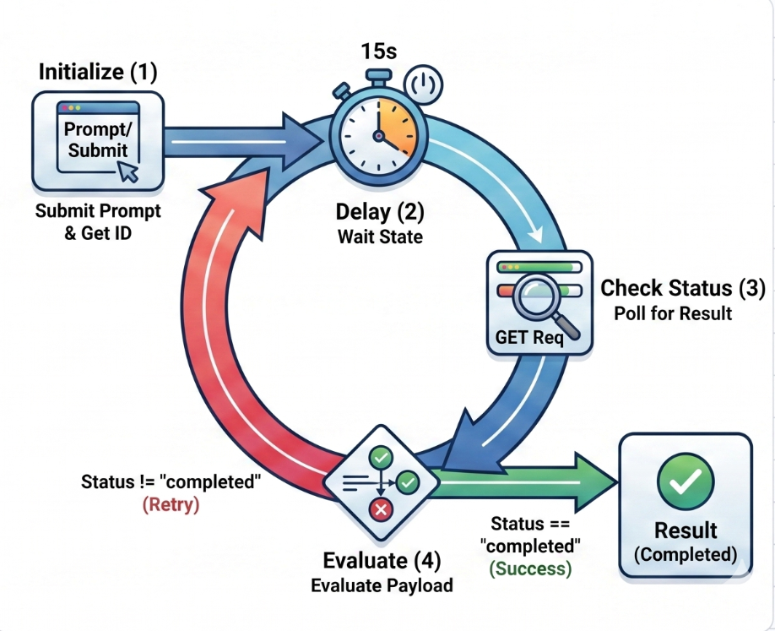
The Asynchronous Polling Pattern
Initialize: Submits the complex prompt and captures the required request_ID.
Delay: Pauses workflow execution for a set duration (e.g., 15s) to prevent API rate-limiting.
Check Status: Polls the external endpoint using the captured request_ID via GET Request.
Evaluate & Route: Evaluates the JSON payload. If status == 'completed', break loop. If false, route back to the Wait State.

Slide 8





Taming Complexity with Sub-Workflows
As automations scale, monolithic canvases become unmanageable. Sub-workflows encapsulate logic.
Spaghetti Workflow
Modular Architecture
All nodes exist on a single canvas. Lines cross randomly. Error handling is impossible to trace. Updating a single node risks breaking the entire massive flow.
A "Master Workflow" orchestrates the high-level logic, executing encapsulated "Child Workflows" (e.g., Validate Input -> Process Data -> Generate Result) via dedicated nodes.
Data Scoping
Isolation
Reusability
Pass strictly defined variables to the child instead of the entire parent payload, improving security and performance.
If an API fails, only the specific child workflow errors out, protecting the master execution logs and allowing targeted retries.
A single data processing sub-workflow can be called by dozens of different parent workflows, maintaining DRY principles.

Slide 9

Infrastructure Selection: Cloud vs. Self-Hosted
 | n8n Cloud | Self-Hosted / Docker
Setup & Maintenance | Zero overhead. Automatic security patches and seamless version updates handled by n8n. | Requires Docker Compose or AWS EC2 setup. Manual version control, backups, and database management.
Security & Control | Managed environment. Subject to external cloud compliance and regional hosting rules. | Airtight. Can run entirely locally behind corporate firewalls. Ideal for strict enterprise data governance.
Cost Structure & Scale | Subscription-based. Task-execution limits based on monthly pricing tiers. Best for rapid deployments. | Pay for your own compute. Unlimited workflow executions. Capable of running local massive LLMs for zero API cost.

Slide 10




The Competitive Edge
"Automation isn't about replacing people. It's about orchestrating systems to free yourself from the mechanical."
DevOps
AI Engineering
Business Operations
Build resilient, self-healing data pipelines that integrate seamlessly with existing tech stacks.
Deploy multi-agent systems and custom RAG applications in hours, rather than weeks of coding.
Transform scattered APIs and siloed tools into unified, intelligent operational engines.

